Slide 1
INNOVATION OF SMART PUBLIC RESTROOM
PREPARED BY
NAME
NAME
NAME
NAME
NAME
1.Mohanraj.P
PROJECT
2.Kabilesh.T.R.V
3.Janakiraman.S
4.Deepath.A
5.Ranjith Kumar.R

Slide 2
INNOVATION OF SMART PUBLIC RESTROOM
DUAC Smart Public Toilet
In India it is estimated that on an average about 60% of the population have no toilets in their homes. The number is still higher in rural areas at about 72%. The condition of the limited number of existing public toilets being pathetic people prefer to defecate in the open thereby compromising themselves to dreadful diseases like cholera, typhoid, hepatitis, jaundice etc. It is estimated that there are above 25 lakh women in Delhi who go for their necessary functions before dawn every morning in the open fields putting their lives to risk in view of the high level of crimes against women. The Commission has always believed that adequate civic amenities help in enhancing the aesthetics of a city. In view of the unsatisfactory situation relating to public toilets in the city of Delhi, the Commission felt that it is high time that an initiative was taken for developing high tech self sustaining public toilets which could be put up in slums, unauthorised colonies, market places and in other places like gardens and parks where foot fall is high. After receiving approval from the Government in the year 2012 on a proposal mooted by it ,the Commission on the basis of a design competition developed a prototype for a low cost self sustaining High-Tech Public Toilets which has been installed at various locations around New Delhi

Slide 3
Objectives
• Distinctive & aesthetically pleasing designs.
• Smart, contemporary and environment friendly features. Industrially prefabricated designs for mass production.
• Long life tenure of approximately 15-20 years.
• Tentative cost INR 1.50 lakh per seat.
• Hassle free transportation to predesignated sites for quick installation.
• Adequate space for advertisement and revenue Generation.

Slide 4
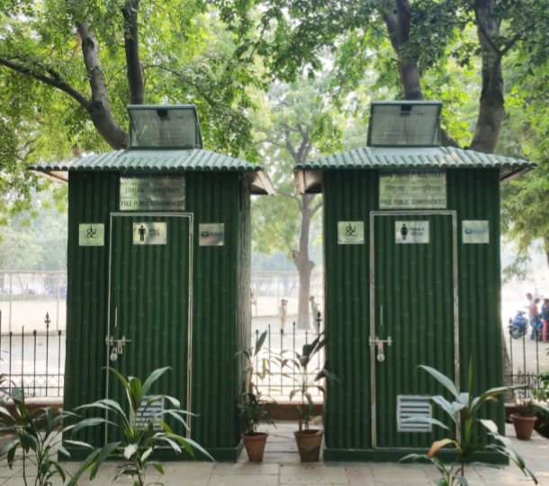
DESIGN 1 (Size of one unit - 1.40m X 1.40m) (Internal height - 2.20m)
Inspired by the vernacular architecture using “Bamboo” as the primary theme.
Specification :
• Exteriors: Fibre reinforced plastic (FRP)
•Interiors: Stainless steel 304 grade , 1mm thick
•Frame: Mild steel (MS)

Slide 5
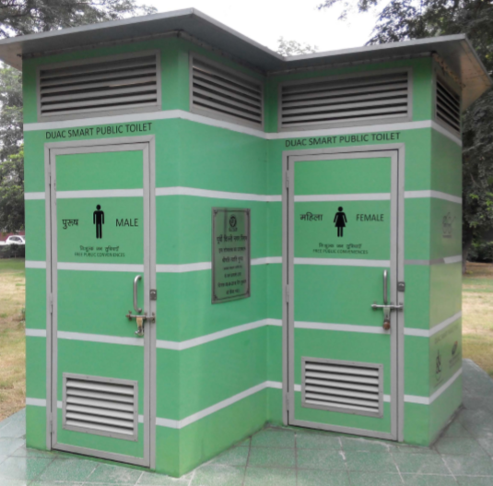
DESIGN 2 (Size of one unit - 1.50m X 2.60m) (Internal height - 2.20m)
A hexagonal twin unit design having male and female compartments alongside.
Specification :
•Exteriors: Polypropylene honey comb, Polyurethane (PU) painted.
•Interiors: Stainless steel 304 grade, 1mm thick
•Frame: Polypropylene honey comb folding wall

